Slide 1
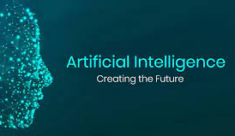
AI Applications
Workshop
By Yuanqi Du

Slide 2


What is Artificial Intelligence?
Weak AI
Simulate human behavior
Strong AI
Act/think exactly like human

Slide 3
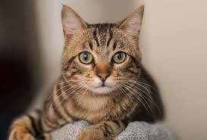



What is Artificial Intelligence?
Data
Intelligence
Learning
Different approaches
Machine learning
Deep learning
And more...
Model
Cat
Prediction

Slide 4
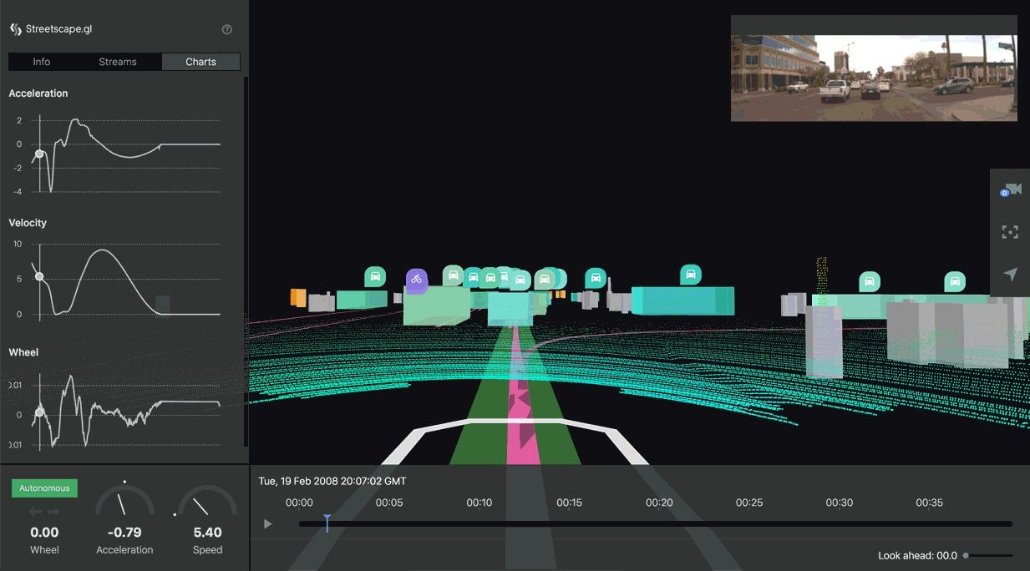
Applications
Computer Vision
E.g. Self-driving car
Natural Language
E.g. Language Translation
Healthcare
E.g. Medical Imaging
Sciences
E.g. Drug Discovery
Finance
E.g. Trading Strategy

Slide 5
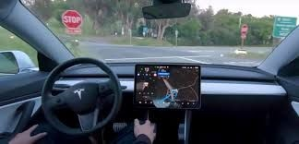
Self-driving Car
Object Detection
Image Segmentation
Multi-sensor system

Slide 6
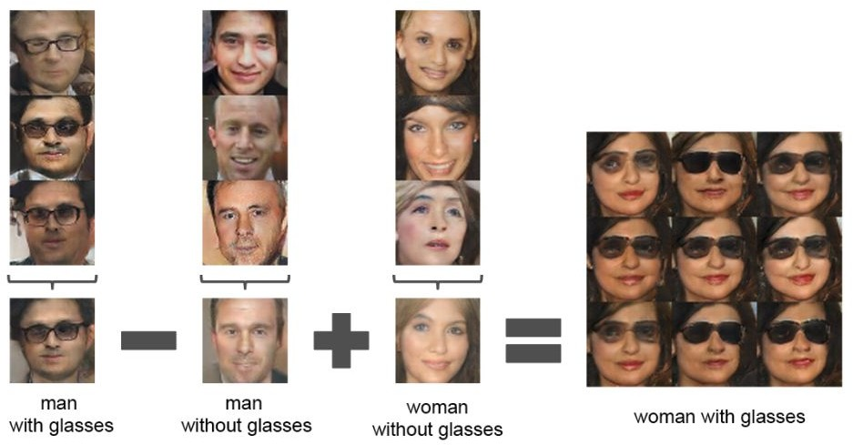
Generative models
E.g. Deepfakes

Slide 7
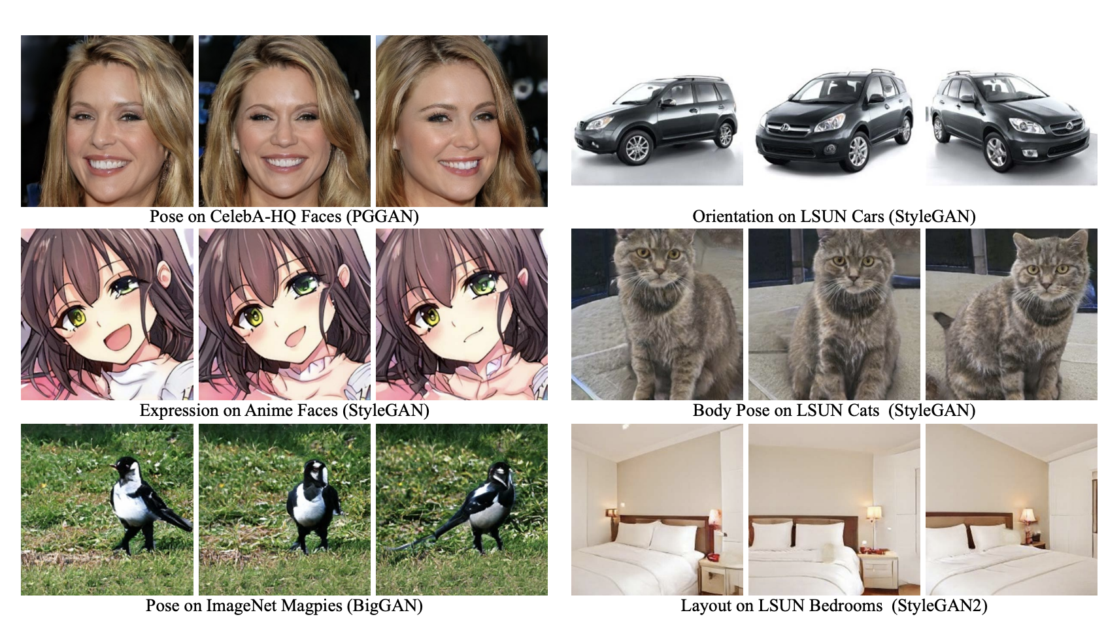
Generative models

Slide 8
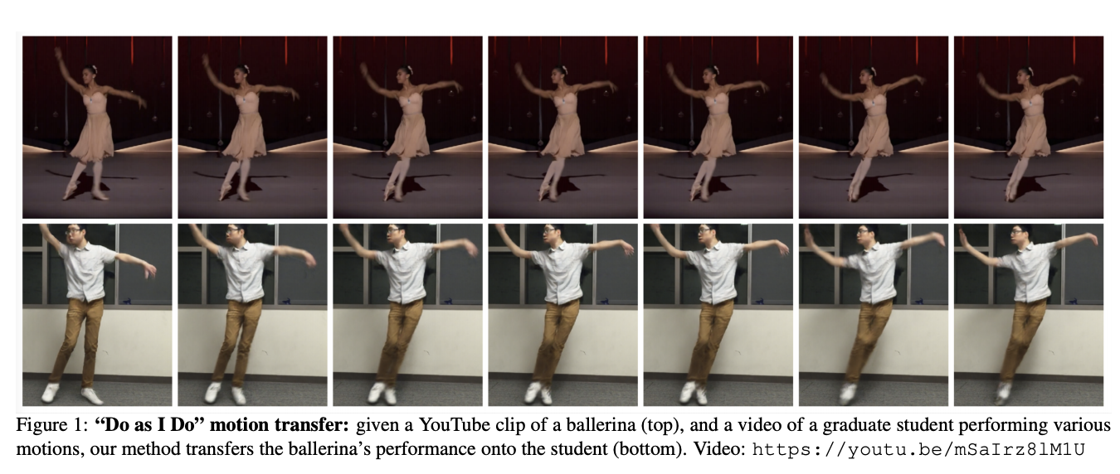
Generative models
E.g. Dancing

Slide 9
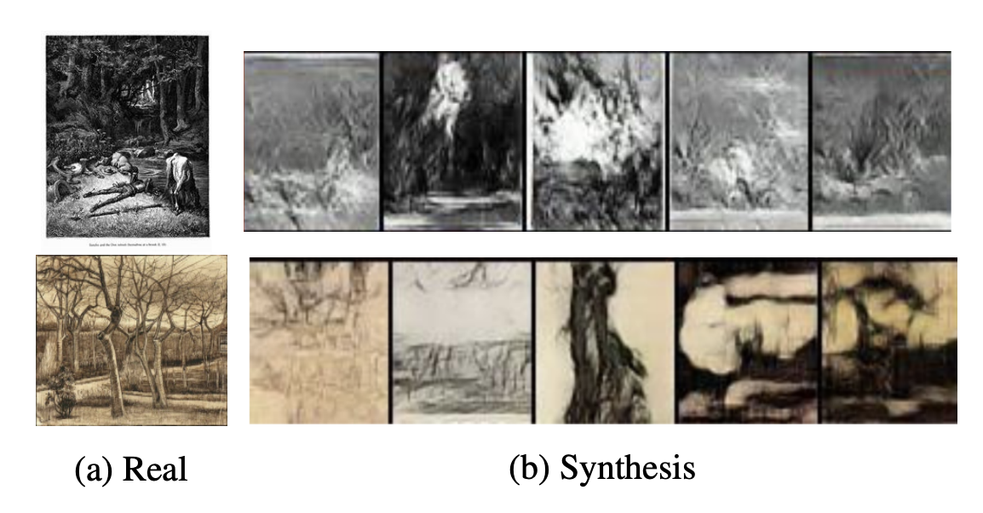
Generative models
E.g. Art

Slide 10
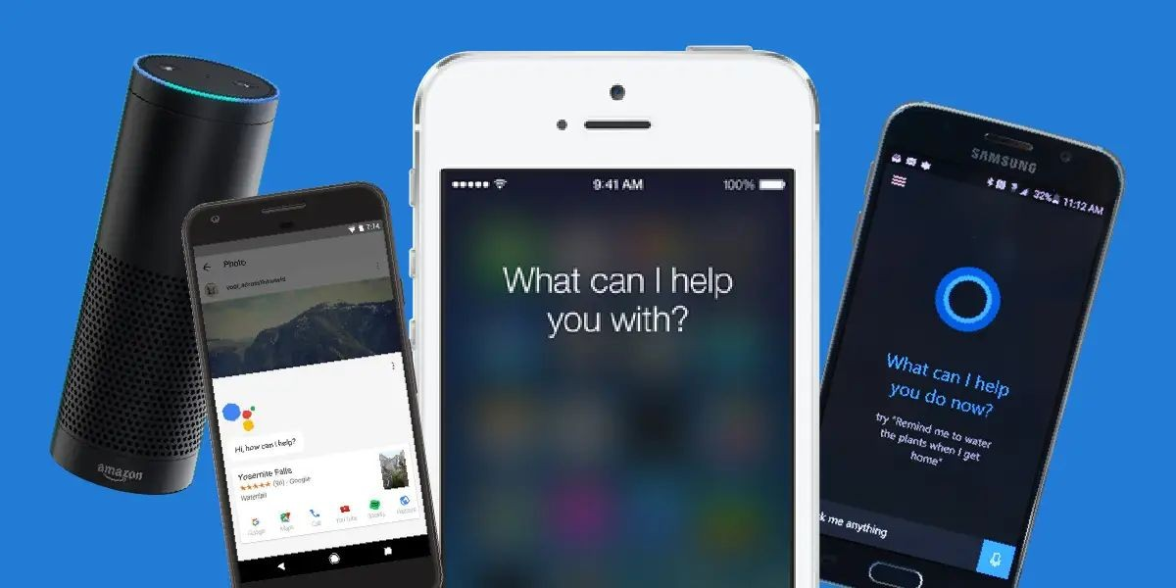
Speech Recognition
Apple - Hi, Siri.
Amazon - Hello, Alexa.
Installed on more apps…
Once it detects the wake-up words, it will start to recognize your speech, and may do translation or do some operations (e.g. set up an alarm).

Slide 11
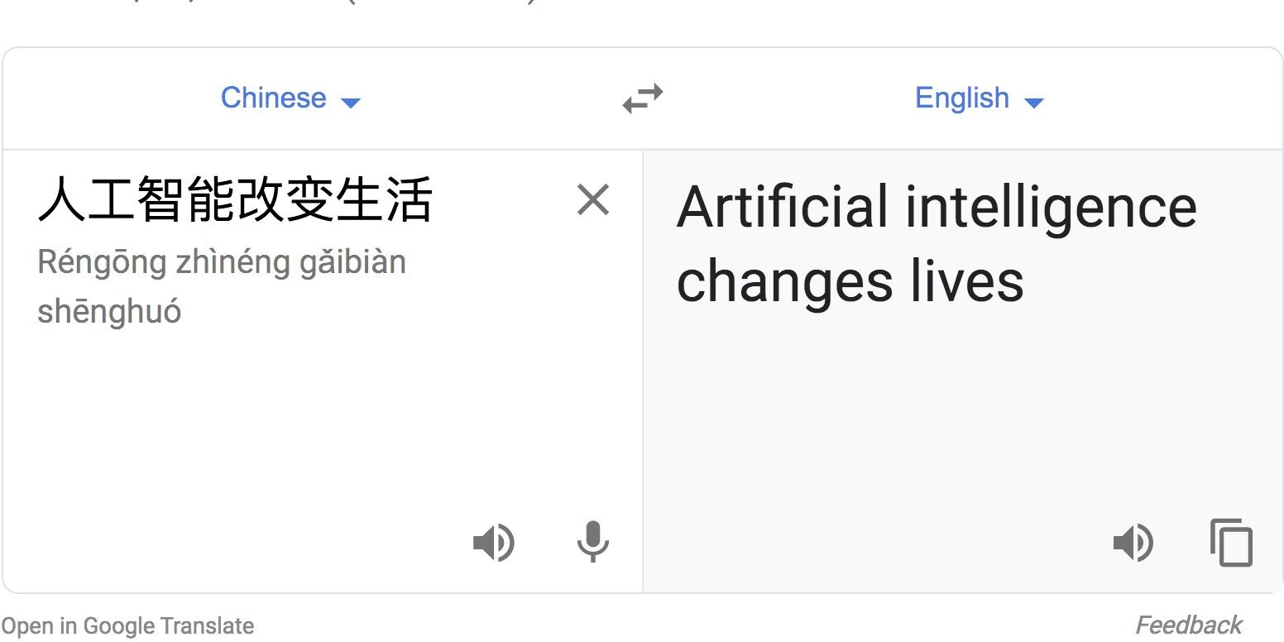
Machine Translation
Google Translate

Slide 12
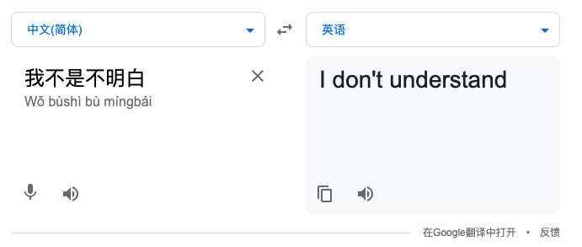
Machine Translation – Where it fails

Slide 13
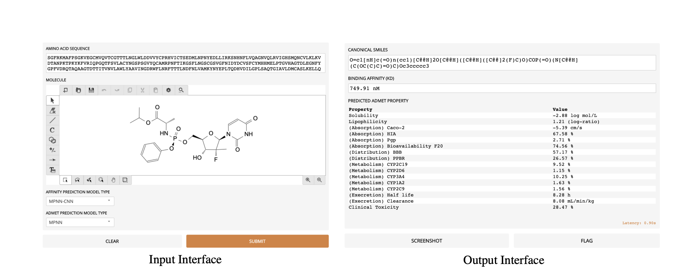
Molecule Design

Slide 14
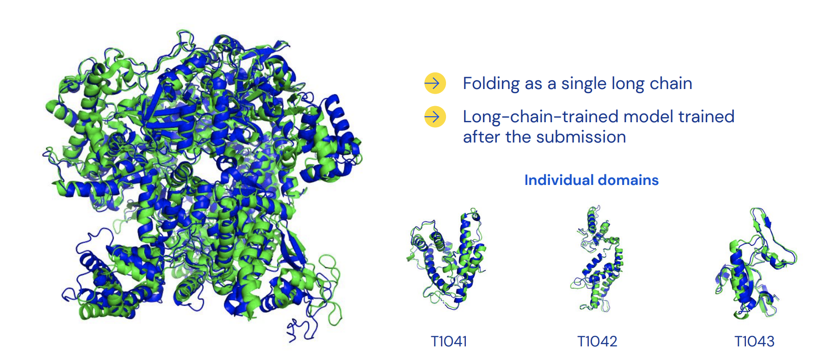
Protein Design & Structure Learning

Slide 15
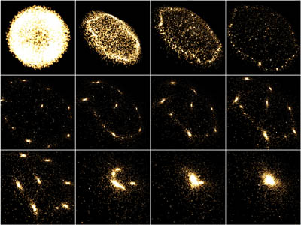
N-Body Simulation

Slide 16
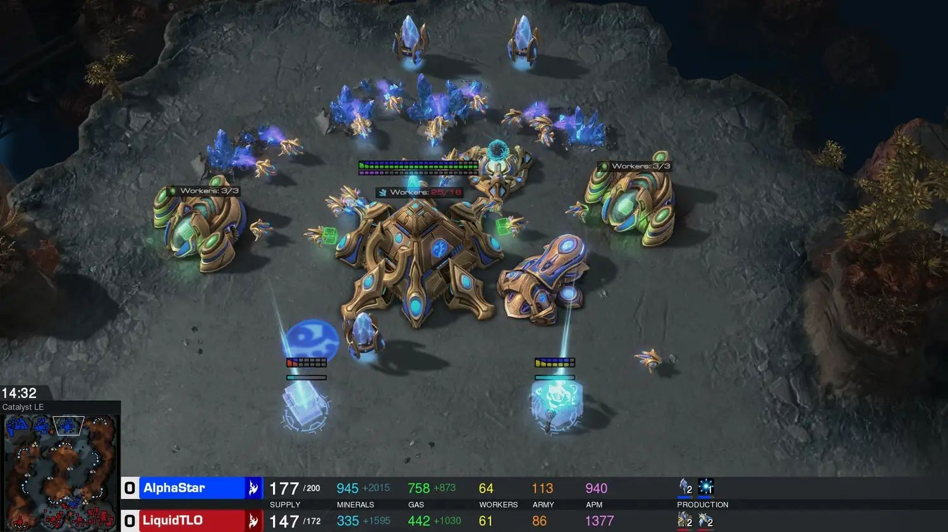

Game Agent
Game AI agent: DeepBlue for chess, AlphaGo for go, AlphaStar for StarCraft II
AlphaStar vs human player
AlphaGo vs Go world champion

Slide 17
Look inside
Data
Where is data from?
Cleaning
Pre-processing
Task
Classification
Clustering
Anomaly Detection
And more...

Slide 18
Look inside
Model
Traditional ML Models
Deep Learning Models
And more...
Evaluation
How good is the model? Metrics? Accuracy?
Does the model generalize to all data? Overfitting? Underfitting?

Slide 19
Look inside
Open source libraries
Numpy, Scipy, Pandas (data processing)
Scikit-learn (Machine Learning/Data Mining)
Tensorflow, Pytorch (Deep Learning)
Matplotlib (Visualizer)
And more...

Slide 20
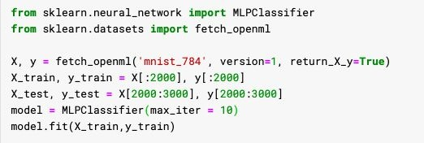
Digits Image Classification
MNIST Dataset:
Want to classify images of handwritten digits

Slide 21

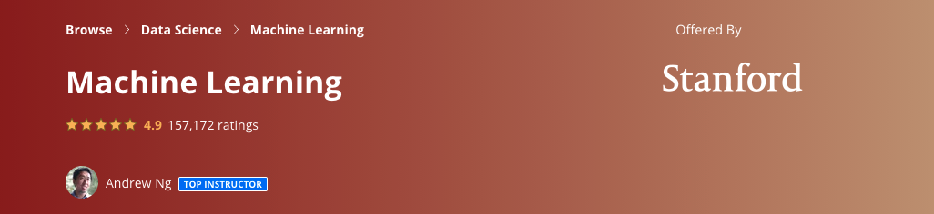
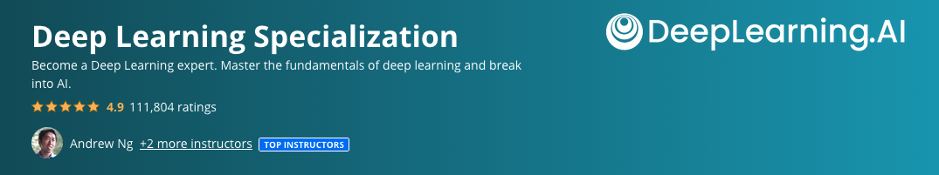
Resources

Slide 22
Research fields
Computer Vision
Natural Language Processing
Generative Modelling
Reinforcement Learning
And more...

Slide 23
Open Discussion
Any topics?

Slide 24
References
https://readwrite.com/2020/08/11/guide-to-understanding-artificial-intelligence/
https://www.google.com.hk/imgres?imgurl=https%3A%2F%2Fdeveloper.nvidia.com%2Fsites%2Fall%2Fmodules%2Fcustom%2Fgpugems%2Fbooks%2FGPUGems3%2FelementLinks%2F31fig01.jpg&imgrefurl=https%3A%2F%2Fdeveloper.nvidia.com%2Fgpugems%2Fgpugems3%2Fpart-v-physics-simulation%2Fchapter-31-fast-n-body-simulation-cuda&tbnid=fZDQvWqaItrkbM&vet=12ahUKEwj7kvK-08_vAhWmyIsBHe8qD-sQMygGegUIARCgAQ..i&docid=BnQbGJIW8wp9cM&w=400&h=300&q=n-body%20simulation&safe=strict&ved=2ahUKEwj7kvK-08_vAhWmyIsBHe8qD-sQMygGegUIARCgAQ
https://predictioncenter.org/casp14/doc/presentations/2020_12_01_TS_predictor_AlphaFold2.pdf
https://ieeexplore.ieee.org/abstract/document/8296985?casa_token=-XjJVBF-ObAAAAAA:NpNJ8IAJN2a3PncTg9Az44xcvcPT-E8HazfEObm734H0NSsysXn4c7_IyDaM2pbmqB5Njqo9v14
https://arxiv.org/abs/2010.03951
https://arxiv.org/pdf/1808.07371
https://arxiv.org/pdf/2007.06600.pdf

